Slide 1
A Hybrid Polytope Exploration-Based Matheuristic Approach to Solve Mixed-Integer Bilevel Linear Programming Problems
${\text{Samuel} \text{Rodr}\text{í}\text{guez} \text{Gonz}\text{á}\text{lez}}^{1,2}$, ${\text{Andr}\text{é}\text{s} \text{D}\text{. }\text{Gonz}\text{á}\text{lez}}^{1},$ ${\text{Camilo} \text{G}\text{ó}\text{mez}}^{2}$
$.^{1}$University of Oklahoma, Norman, OK, US
$.^{2}$Universidad de los Andes, Bogotá, Colombia
IISE Annual Conference
Seattle, WA, May 24th 2022

Slide 2








What can we model with bilevel optimization
Energy distributor
Final consumers
Consumer profiles

Slide 3





Practical application: Public Private Partnerships (PPP)
Inspection actions
Penalties/rewards
Government’s objective is to maximize the social Benefit of the system
Contractor’s objective is to maximize their profit
Maintenance actions
The rules are set in the contract, however, there is asymmetry of information (i.e., agency problem)
Social benefit
Camilo Gomez et al. “An exact optimization approach to the principal-agent problem in infrastructure projects via PPPs”, 2020

Slide 4

Motivation: Bilevel Optimization
First level/Leader
$$\min{Z=\sum_{{j∈J}_{x}}{c_{j}^{x}⋅x_{j}}}+\sum_{{j∈J}_{y}}{c_{j}^{y}⋅y_{j}}$$
s.t.,
$$\sum_{{j∈J}_{x}}{G_{ij}^{x}⋅x_{j}}+\sum_{{j∈J}_{y}}{G_{ij}^{x}⋅y_{j}≤b_{i}^{x}} ∀ i=1,…,m_{x}$$
$$y∈\arg{\min\left\{\begin{aligned}\sum_{{j∈J}_{y}}{d_{j}^{y}⋅y_{j}}:\sum_{{j∈J}_{y}}{B_{ij}^{y}⋅y_{j}≤b_{i}^{y}−\sum_{{j∈J}_{x}}{A_{ij}^{y}⋅x_{j}}}, ∀ i=1,…,m_{y} \\ y_{j}≥0 ∀ j∈J_{y}\end{aligned}\right\}}$$
$$x_{j}≥0 ∀ j∈J_{x}$$
$$y_{j}≥0 ∀ j∈J_{y}$$
BLP
Second level/Follower
Fischetti et al. “A New General-Purpose Algorithm for Mixed-Integer Bilevel Linear Programs”, 2017

Slide 5

Motivation: Bilevel Optimization
$$\min{Z=\sum_{{j∈J}_{x}}{c_{j}^{x}⋅x_{j}}}+\sum_{{j∈J}_{y}}{c_{j}^{y}⋅y_{j}}$$
s.t.,
$$\sum_{{j∈J}_{x}}{G_{ij}^{x}⋅x_{j}}+\sum_{{j∈J}_{y}}{G_{ij}^{x}⋅y_{j}≤b_{i}^{x}} ∀ i=1,…,m_{x}$$
$$y∈\arg{\min\left\{\begin{aligned}\sum_{{j∈J}_{y}}{d_{j}^{y}⋅y_{j}}:\sum_{{j∈J}_{y}}{B_{ij}^{y}⋅y_{j}≤b_{i}^{y}−\sum_{{j∈J}_{x}}{A_{ij}^{y}⋅x_{j}}}, ∀ i=1,…,m_{y} \\ y_{j}∈ℤ^{≥0} ∀ j=1,…,n_{1}^{y},y_{j}≥0 ∀ j=n_{1}^{y}+1,…,\left|J_{y}\right| \end{aligned}\right\}}$$
$$x_{j}∈ℤ^{≥0} ∀ j=1,…,n_{1}^{x},x_{j}≥0 ∀ j=n_{1}^{x}+1,…,\left|J_{x}\right|$$
$$y_{j}∈ℤ^{≥0} ∀ j=1,…,n_{1}^{y},y_{j}≥0 ∀ j=n_{1}^{y}+1,…,\left|J_{y}\right|$$
MIBLP
Fischetti et al. “A New General-Purpose Algorithm for Mixed-Integer Bilevel Linear Programs”, 2017

Slide 6
Literature review
Author(s) | Title | Year
Fischetti, Matteo Ljubić, Ivana Monaci, Michele Sinnl, Markus | A new general-purpose algorithm for mixed-integer bilevel linear programs | 2017
Tang, Yen Richard, Jean Philippe P. Smith, J. Cole | A class of algorithms for mixed-integer bilevel min–max optimization | 2016
Sinha, Ankur Malo, Pekka Deb, Kalyanmoy | A Review on Bilevel Optimization: From Classical to Evolutionary Approaches and Applications | 2017
Bard, J. Moore, J. | A Branch and Bound Algorithm for the Bilevel Programming Problem | 1990
State-of-the-art:
Branch & Bound
Branch & Cut
Interdiction problems
Deals with binary variables
Review on bilevel solution approaches and characteristics
Difficulties arising from non-convexity (e.g., optimality gap no longer holds)

Slide 7
Solution approaches
Single level reductions:
Branch & Bound
Branch & Cut
KKT Optimality conditions
Trust region methods
Penalization methods
Evolutionary algorithms
Computationally exhaustive
Relies on strong assumptions

Slide 8
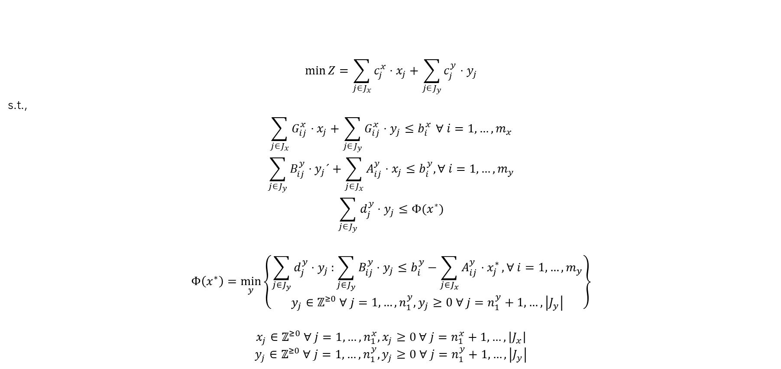
Motivation: Bilevel Optimization
$$\min{Z=\sum_{{j∈J}_{x}}{c_{j}^{x}⋅x_{j}}}+\sum_{{j∈J}_{y}}{c_{j}^{y}⋅y_{j}}$$
s.t.,
$$\sum_{{j∈J}_{x}}{G_{ij}^{x}⋅x_{j}}+\sum_{{j∈J}_{y}}{G_{ij}^{x}⋅y_{j}≤b_{i}^{x}} ∀ i=1,…,m_{x}$$
$$\sum_{{j∈J}_{y}}{B_{ij}^{y}⋅y_{j}´}+\sum_{{j∈J}_{x}}{A_{ij}^{y}⋅x_{j}}≤b_{i}^{y}, ∀ i=1,…,m_{y}$$
$$\sum_{{j∈J}_{y}}{d_{j}^{y}⋅y_{j}}≤Φ(x^{∗})$$
$$Φ\left(x^{∗}\right)=\min_{y}\left\{\begin{aligned}\sum_{{j∈J}_{y}}{d_{j}^{y}⋅y_{j}}:\sum_{{j∈J}_{y}}{B_{ij}^{y}⋅y_{j}≤b_{i}^{y}−\sum_{{j∈J}_{x}}{A_{ij}^{y}⋅x_{j}^{∗}}}, ∀ i=1,…,m_{y} \\ y_{j}∈ℤ^{≥0} ∀ j=1,…,n_{1}^{y},y_{j}≥0 ∀ j=n_{1}^{y}+1,…,\left|J_{y}\right| \end{aligned}\right\}$$
$$x_{j}∈ℤ^{≥0} ∀ j=1,…,n_{1}^{x},x_{j}≥0 ∀ j=n_{1}^{x}+1,…,\left|J_{x}\right|$$
$$y_{j}∈ℤ^{≥0} ∀ j=1,…,n_{1}^{y},y_{j}≥0 ∀ j=n_{1}^{y}+1,…,\left|J_{y}\right|$$
Value function formulation
J. V. Outrata. “On the numerical solution of a class of Stackelberg problems”. In:Zeitschrift fur Operations Research34.4 (July 1990),

Slide 9
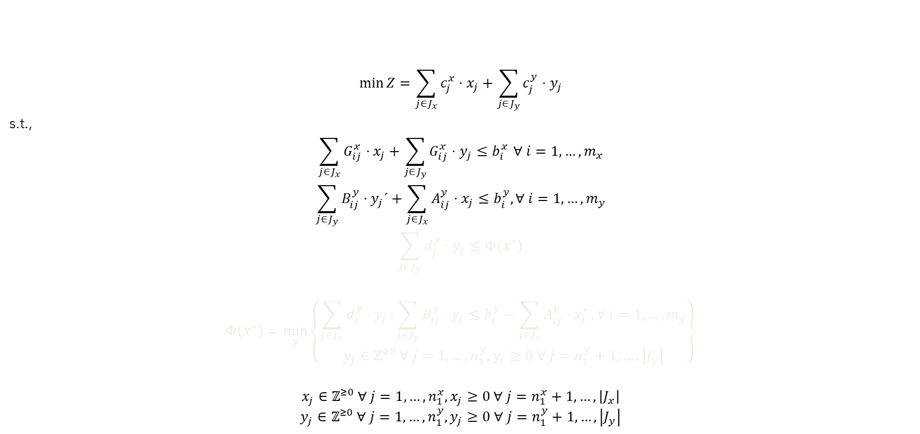
Motivation: Bilevel Optimization
$$\min{Z=\sum_{{j∈J}_{x}}{c_{j}^{x}⋅x_{j}}}+\sum_{{j∈J}_{y}}{c_{j}^{y}⋅y_{j}}$$
s.t.,
$$\sum_{{j∈J}_{x}}{G_{ij}^{x}⋅x_{j}}+\sum_{{j∈J}_{y}}{G_{ij}^{x}⋅y_{j}≤b_{i}^{x}} ∀ i=1,…,m_{x}$$
$$\sum_{{j∈J}_{y}}{B_{ij}^{y}⋅y_{j}´}+\sum_{{j∈J}_{x}}{A_{ij}^{y}⋅x_{j}}≤b_{i}^{y}, ∀ i=1,…,m_{y}$$
$$\sum_{{j∈J}_{y}}{d_{j}^{y}⋅y_{j}}≤Φ(x^{∗})$$
$$Φ\left(x^{∗}\right)=\min_{y}\left\{\begin{aligned}\sum_{{j∈J}_{y}}{d_{j}^{y}⋅y_{j}}:\sum_{{j∈J}_{y}}{B_{ij}^{y}⋅y_{j}≤b_{i}^{y}−\sum_{{j∈J}_{x}}{A_{ij}^{y}⋅x_{j}^{∗}}}, ∀ i=1,…,m_{y} \\ y_{j}∈ℤ^{≥0} ∀ j=1,…,n_{1}^{y},y_{j}≥0 ∀ j=n_{1}^{y}+1,…,\left|J_{y}\right| \end{aligned}\right\}$$
$$x_{j}∈ℤ^{≥0} ∀ j=1,…,n_{1}^{x},x_{j}≥0 ∀ j=n_{1}^{x}+1,…,\left|J_{x}\right|$$
$$y_{j}∈ℤ^{≥0} ∀ j=1,…,n_{1}^{y},y_{j}≥0 ∀ j=n_{1}^{y}+1,…,\left|J_{y}\right|$$
High Point Relaxation (HPR)
J. V. Outrata. “On the numerical solution of a class of Stackelberg problems”. In:Zeitschrift fur Operations Research34.4 (July 1990),

Slide 10


Motivation: Bilevel Optimization
$$\min{Z=\sum_{{j∈J}_{x}}{c_{j}^{x}⋅x_{j}}}+\sum_{{j∈J}_{y}}{c_{j}^{y}⋅y_{j}}$$
s.t.,
$$\sum_{{j∈J}_{x}}{G_{ij}^{x}⋅x_{j}}+\sum_{{j∈J}_{y}}{G_{ij}^{x}⋅y_{j}≤b_{i}^{x}} ∀ i=1,…,m_{x}$$
$$\sum_{{j∈J}_{y}}{B_{ij}^{y}⋅y_{j}´}+\sum_{{j∈J}_{x}}{A_{ij}^{y}⋅x_{j}}≤b_{i}^{y}, ∀ i=1,…,m_{y}$$
$$\sum_{{j∈J}_{y}}{d_{j}^{y}⋅y_{j}}≤Φ(x^{∗})$$
$$Φ\left(x^{∗}\right)=\min_{y}\left\{\begin{aligned}\sum_{{j∈J}_{y}}{d_{j}^{y}⋅y_{j}}:\sum_{{j∈J}_{y}}{B_{ij}^{y}⋅y_{j}≤b_{i}^{y}−\sum_{{j∈J}_{x}}{A_{ij}^{y}⋅x_{j}^{∗}}}, ∀ i=1,…,m_{y} \\ y_{j}∈ℤ^{≥0} ∀ j=1,…,n_{1}^{y},y_{j}≥0 ∀ j=n_{1}^{y}+1,…,\left|J_{y}\right| \end{aligned}\right\}$$
$$x_{j}≥0 ∀ j∈J_{x}$$
$$y_{j}≥0 ∀ j∈J_{y}$$
$$\left(\overline{HPR}\right)$$
J. V. Outrata. “On the numerical solution of a class of Stackelberg problems”. In:Zeitschrift fur Operations Research34.4 (July 1990),

Slide 11
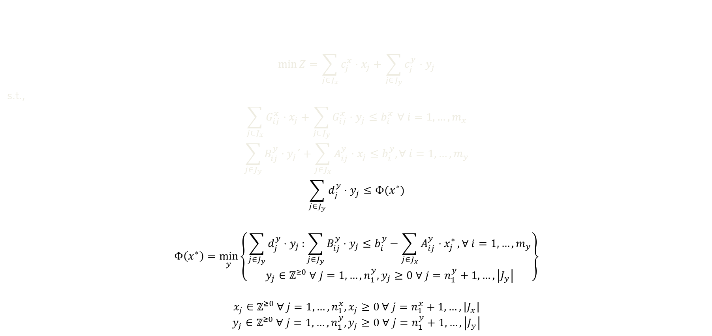
Motivation: Bilevel Optimization
$$\min{Z=\sum_{{j∈J}_{x}}{c_{j}^{x}⋅x_{j}}}+\sum_{{j∈J}_{y}}{c_{j}^{y}⋅y_{j}}$$
s.t.,
$$\sum_{{j∈J}_{x}}{G_{ij}^{x}⋅x_{j}}+\sum_{{j∈J}_{y}}{G_{ij}^{x}⋅y_{j}≤b_{i}^{x}} ∀ i=1,…,m_{x}$$
$$\sum_{{j∈J}_{y}}{B_{ij}^{y}⋅y_{j}´}+\sum_{{j∈J}_{x}}{A_{ij}^{y}⋅x_{j}}≤b_{i}^{y}, ∀ i=1,…,m_{y}$$
$$\sum_{{j∈J}_{y}}{d_{j}^{y}⋅y_{j}}≤Φ(x^{∗})$$
$$Φ\left(x^{∗}\right)=\min_{y}\left\{\begin{aligned}\sum_{{j∈J}_{y}}{d_{j}^{y}⋅y_{j}}:\sum_{{j∈J}_{y}}{B_{ij}^{y}⋅y_{j}≤b_{i}^{y}−\sum_{{j∈J}_{x}}{A_{ij}^{y}⋅x_{j}^{∗}}}, ∀ i=1,…,m_{y} \\ y_{j}∈ℤ^{≥0} ∀ j=1,…,n_{1}^{y},y_{j}≥0 ∀ j=n_{1}^{y}+1,…,\left|J_{y}\right| \end{aligned}\right\}$$
$$x_{j}∈ℤ^{≥0} ∀ j=1,…,n_{1}^{x},x_{j}≥0 ∀ j=n_{1}^{x}+1,…,\left|J_{x}\right|$$
$$y_{j}∈ℤ^{≥0} ∀ j=1,…,n_{1}^{y},y_{j}≥0 ∀ j=n_{1}^{y}+1,…,\left|J_{y}\right|$$
Bilevel feasibility
J. V. Outrata. “On the numerical solution of a class of Stackelberg problems”. In:Zeitschrift fur Operations Research34.4 (July 1990),

Slide 12
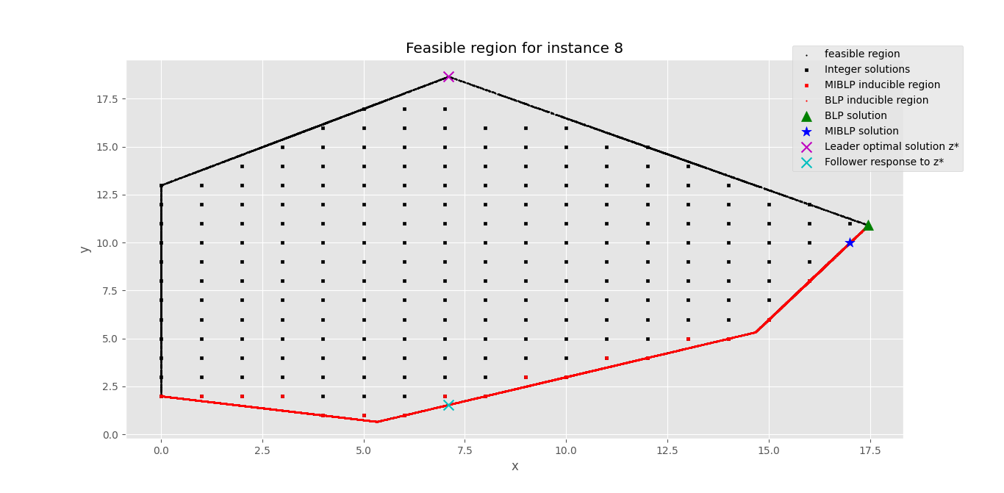

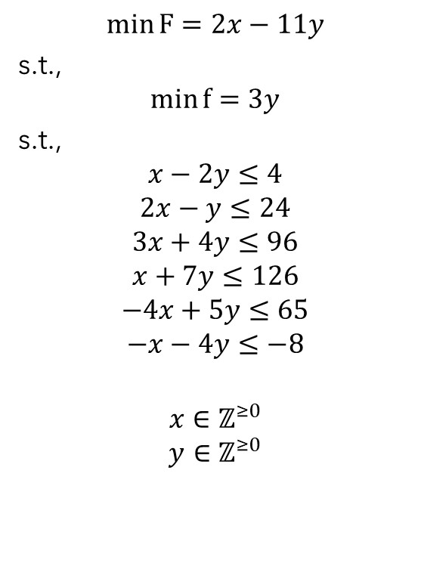

Example’s feasible region
$$\min{F=2x−11y}$$
s.t.,
$$\min{f=3y}$$
s.t.,
$$x−2y≤4$$
$$2x−y≤24$$
$$3x+4y≤96$$
$$x+7y≤126$$
$$−4x+5y≤65$$
$$−x−4y≤−8$$
$$x∈ℤ^{≥0}$$
$$y∈ℤ^{≥0}$$
$$∇f$$
$$∇F$$

Slide 13

Exploring the interior of the feasible region

Slide 14


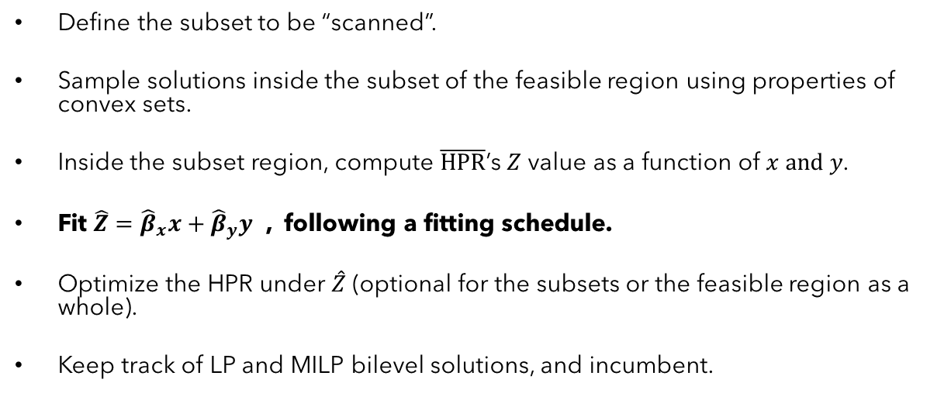
Scanner
Define the subset to be “scanned”.
Sample solutions inside the subset of the feasible region using properties of convex sets.
Inside the subset region, compute $\overline{HPR}$’s $Z$ value as a function of $x and y$.
Fit $\hat{Z}={\hat{β}}_{x}x+{\hat{β}}_{y}y$ , following a fitting schedule.
Optimize the HPR under $\hat{Z}$ (optional for the subsets or the feasible region as a whole).
Keep track of LP and MILP bilevel solutions, and incumbent.

Slide 15

Exploring the interior of the feasible region
$$Gap_{MIBLP}=\frac{\left|{MIBLP}_{sol}−{BLP}_{sol}\right|}{\left|MIBLP_{sol}\right|}$$

Slide 16

Exploring the interior of the feasible region
$$∇\hat{Z}$$

Slide 17
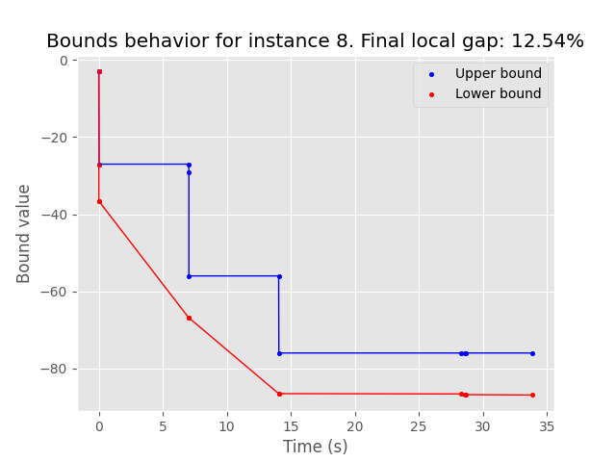

Example results: 12.54%
$$\min{F=2x−11y}$$
s.t.,
$$\min{f=3y}$$
s.t.,
$$x−2y≤4$$
$$2x−y≤24$$
$$3x+4y≤96$$
$$x+7y≤126$$
$$−4x+5y≤65$$
$$−x−4y≤−8$$
$$x∈ℤ^{≥0}$$
$$y∈ℤ^{≥0}$$

Slide 18
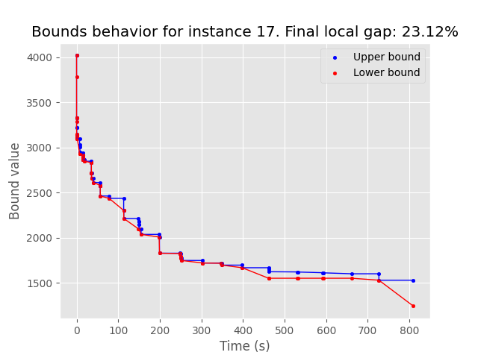
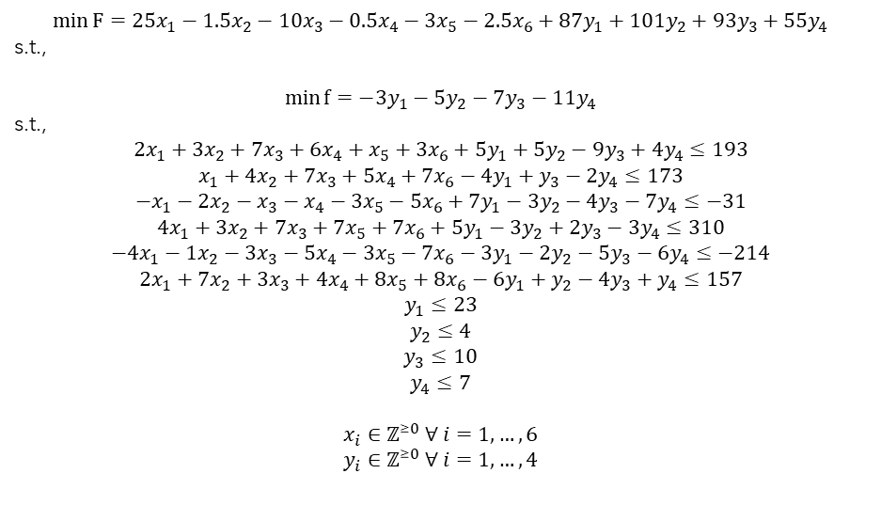
Biggest test instance results: 23.12% gap
$$\min{F=25x_{1}−1.5x_{2}−10x_{3}−0.5x_{4}−3x_{5}−2.5x_{6}+87y_{1}+101y_{2}+93y_{3}+55y_{4}}$$
s.t.,
$${\min{f=−3y}}_{1}−5y_{2}−7y_{3}−11y_{4}$$
s.t.,
$$2x_{1}+3x_{2}+7x_{3}+6x_{4}+x_{5}+3x_{6}+5y_{1}+5y_{2}−9y_{3}+4y_{4}≤193$$
$$x_{1}+4x_{2}+7x_{3}+5x_{4}+7x_{6}−4y_{1}+y_{3}−2y_{4}≤173$$
$${−x}_{1}−2x_{2}−x_{3}−x_{4}−3x_{5}−5x_{6}+7y_{1}−3y_{2}−4y_{3}−7y_{4}≤−31$$
$$4x_{1}+3x_{2}+7x_{3}+7x_{5}+7x_{6}+5y_{1}−3y_{2}+2y_{3}−3y_{4}≤310$$
$$−4x_{1}−1x_{2}−3x_{3}−5x_{4}−3x_{5}−7x_{6}−3y_{1}−2y_{2}−5y_{3}−6y_{4}≤−214$$
$$2x_{1}+7x_{2}+3x_{3}+4x_{4}+8x_{5}+8x_{6}−6y_{1}+y_{2}−4y_{3}+y_{4}≤157$$
$$y_{1}≤23$$
$$y_{2}≤4$$
$$y_{3}≤10$$
$$y_{4}≤7$$
$$x_{i}∈ℤ^{≥0} ∀ i=1,…, 6$$
$$y_{i}∈ℤ^{≥0} ∀ i=1,…, 4$$

Slide 19
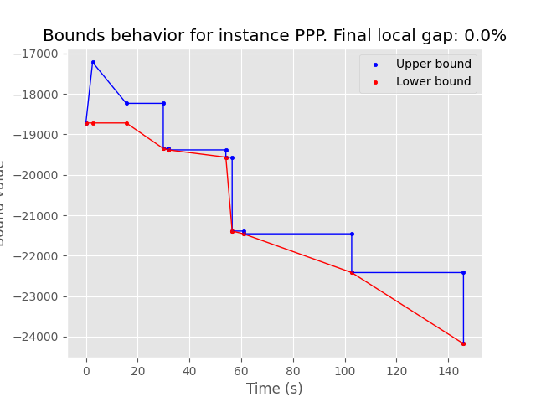
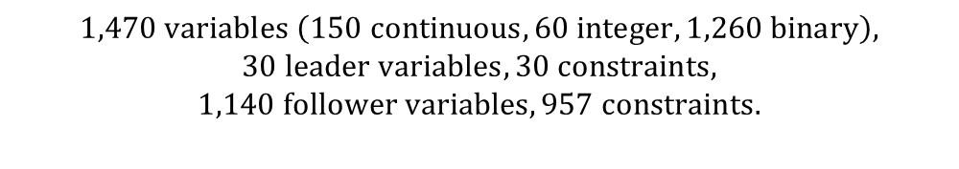

PPP case study: 00.00% gap
$$\max{Social benefit}$$
s.t.,
$$minimum social benefit requirement$$
$$\max{Agent^{′}s cashflow}$$
s.t.,
$$Infrastructure performance$$
$$Performance→service level mapping$$
$$Cashflow dynamics$$
$$Variables domain$$
$$1,470 variables \left(150 continuous,60 integer, 1,260 binary\right),$$
$$30 leader variables, 30 constraints,$$
$$1,140 follower variables, 957 constraints.$$

Slide 20



Concluding remarks
We encourage the use of matheuristics to solve and analyze non-convex optimization problems.
We provided a way to estimate the intrinsic objective function coefficients for the leader under the MIBLP framework.
We used fundamental ideas from LP and MILP paradigms, as well as basic ideas of convex sets.
We created a methodology to retrieve a set of bilevel feasible and possibly optimal solutions for MIB(L)Ps.
We introduced a solution quality measure: MIBLP gap.
$$∇f$$
$$∇f$$
$$∇\hat{Z}$$
$$∇\hat{Z}$$
$$∇F$$
$$∇F$$

Slide 21
Future work
Incorporate more intelligent ways to generate the “scan” on a subset of the feasible region.
Apply valid inequalities to “cut” bilevel infeasible solutions to reduce the area of exploration, such as Intersection Cuts (Conforti et al., 2014).
Test the implementation over instances of Mixed-Integer Bilevel Non-linear Programing problems (MIBNLPs).
$$∇f$$
$$∇\hat{Z}$$
$$∇F$$

Slide 22
References
Mohamed Alloghani et al.A Systematic Reviewon Supervised and Unsupervised Machine LearningAlgorithms for Data Science. Ed. by Michael W.Berry, Azlinah Mohamed, and Bee Wah Yap. Cham:Springer International Publishing, 2020, pp. 3–21.ISBN: 978-3-030-22475-2.DOI: 10 . 1007 / 978 - 3 -030-22475-21.URL: https://doi.org/10.1007/978-3-030-22475-21
J. F. Bard. “Some properties of the bilevel program-ming problem”. In:Journal of Optimization Theoryand Applications68.2 (Feb. 1991), pp. 371–378.ISSN: 1573-2878.DOI: 10.1007/BF00941574.URL:https://doi.org/10.1007/BF00941574
Jonathan F. Bard and James T. Moore. “A Branchand Bound Algorithm for the Bilevel ProgrammingProblem”. In:SIAM J. Sci. Stat. Comput.11.2(1990), pp. 281–292.ISSN: 0196-5204.DOI: 10 .1137/0911017
Michele Conforti, G ́erard Cornu ́ejols, and GiacomoZambelli. “Equivalence between intersection cutsand the corner polyhedron”. In:Oper. Res. Lett.38.3 (2010), pp. 153–155.ISSN: 01676377.DOI:10.1016/j.orl.2010.02.006.URL: www.elsevier.com/locate/orl
Matteo Fischetti et al. “A New General-PurposeAlgorithm for Mixed-Integer Bilevel Linear Pro-grams”. In:Oper. Res.65.6 (Dec. 2017), pp. 1615–1637.ISSN: 0030-364X.DOI: 10.1287/opre.2017.1650.URL: https://doi.org/10.1287/opre.2017.1650
C. D. Kolstad and L. S. Lasdon. “Derivative evalua-tion and computational experience with large bilevelmathematical programs”. In:J. Optim. Theory Appl.65.3 (1990), pp. 485–499.ISSN: 00223239.DOI:10.1007/BF00939562
A. Kov ́acs. “On the Computational Complexity of Tariff Optimization for Demand Response Manage-ment”. In:IEEE Transactions on Power Systems33.3 (May 2018), pp. 3204–3206.DOI: 10 . 1109 /TPWRS.2018.2802198
H. Li, L. Zhang, and Y. Jiao. “Solution for integer linear bilevel programming problems using orthogonal genetic algorithm”. In:Journal of Systems En-gineering and Electronics25.3 (2014), pp. 443–451
Ngo Van Long and Gerhard Sorger. “A dynamicprincipal-agent problem as a feedback Stackelbergdifferential game”. In:Central European Journal ofOperations Research18 (2010), pp. 491–509
J. V. Outrata. “On the numerical solution of aclass of Stackelberg problems”. In:Zeitschrift f ̈urOperations Research34.4 (July 1990), pp. 255–277. 17ISSN: 1432-5217.DOI: 10.1007/BF01416737.URL:https://doi.org/10.1007/BF01416737
Ankur Sinha, Pekka Malo, and Kalyanmoy Deb.“A Review on Bilevel Optimization: From Classicalto Evolutionary Approaches and Applications”. In:IEEE Transactions on Evolutionary Computation22(2017), pp. 276–295
Yen Tang, Jean-Philippe P. Richard, and J. ColeSmith. “A Class of Algorithms for Mixed-IntegerBilevel Min—Max Optimization”. In:J. of GlobalOptimization66.2 (Oct. 2016), pp. 225–262.ISSN:0925-5001.DOI: 10 . 1007 / s10898 - 015 - 0274 - 7.URL: https://doi.org/10.1007/s10898-015-0274-7
Hoang Tuy, Athanasios Migdalas, and PeterV ̈arbrand. “A global optimization approach for thelinear two-level program”. In:J. Glob. Optim.3.1(1993), pp. 1–23.ISSN: 09255001.DOI: 10.1007/BF01100237.URL: https : / / link - springer - com .ezproxy . uniandes . edu . co : 8443 / content / pdf / 10 .1007%7B%5C%%7D2FBF01100237.pdf

Slide 23


